Slide 1

UCL AI FESTIVAL HACKATHON
AetherTest (Agentic AI)
The Autonomous STLC Engine
Zero-Touch AI Testing
Natarajan Muthu & Sravanth Baratam
Feb 2026
End-to-End Testing Innovation

Slide 2
Overview
Journey Overview
01
The Problem
02
The Solution
03
Differentiation
Fragmented Testing Lifecycle
AetherTest Architecture
Why AetherTest Changes Everything
Three Autonomous Layers
The Translation Gap
Vision-Language Intelligence
vs Traditional Tools
Impact of Manual Testing
Browser-Use Agent
Expected Outcomes
From Low-Code to Zero-Touch AI Driven Test Automation

Slide 3

01
Chapter One
The Problem
The fragmented STLC and the translation gap bottleneck that cripples Agile velocity
Understanding the Critical Challenge

Slide 4
The Core Challenge
The Translation Gap
Why manual interpretation creates the #1 bottleneck in Agile sprints
Fragmented STLC
The Translation Pipeline
The Software Testing Life Cycle is broken into disconnected phases. Human testers must manually bridge the gap between design intent and test execution.
Figma Design
Manual Interpretation
PRD Document
Testers translate Figma designs and PRDs into Java/Python/JavaScript test scripts. Every requirement must be manually converted into executable code.
Human Tester
Manual Interpretation
"Low-Code" Limitations
Even "low-code" tools require manual recording or element selection. They don't eliminate the translation—they just change the format.
Test Scripts
Time-Consuming & Error-Prone
The #1 Bottleneck
This manual translation is the primary blocker in Agile sprints

Slide 5
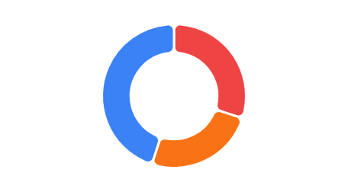
Critical Consequences
The Impact of Manual Testing
Three critical consequences that cripple testing efficiency
Desynchronization
Tester Time Allocation
Test scripts consistently lag behind UI changes. Every design update requires manual script updates, creating a perpetual catch-up cycle.
Continuous drift between design and tests
Maintenance Overhead
30% of tester time is spent fixing brittle selectors. XPath and CSS selectors break with every minor UI adjustment.
Time diverted from actual testing
Maintenance
30%
Release Delays
Automation cannot start until code is "stable," delaying the feedback loop. Testing becomes a post-development bottleneck rather than a continuous process.
Script Writing
25%
Shift-Right instead of Shift-Left
Actual Testing
45%

Slide 6
02
Chapter Two
The Solution
AetherTest — Zero-Touch AI Testing Platform that orchestrates the entire STLC autonomously
Three Autonomous Layers Working in Harmony

Slide 7
System Architecture
AetherTest Architecture
Three autonomous layers orchestrating end-to-end testing
LAYER 01
LAYER 03
The Intake Layer
The Execution Layer
Users upload testing inputs through a unified interface. The system accepts multiple source formats and prepares them for cognitive processing.
AI Agent using browser-use library navigates the live application like a human. Understands context, clicks buttons, fills forms, validates logic based on visual cues.
Figma URL
Requirements
Web App URL
Visual-Based Interaction
LAYER 02
The Cognitive Layer
Key Innovation
Multimodal LLMs compare "Expected State" (Figma) with "Actual State" (Live Web URL). Automatically generates logical test cases in plain natural language.
Live Agent View
Embedded Next.js window showing real-time AI navigation
Self-Healing by Design
LLM reasoning adapts to UI changes automatically
Vision-Language Intelligence

Slide 8
Layer 02 Deep Dive
The Cognitive Layer
Vision-Language Intelligence that "sees" and understands
Multimodal LLM Power
Vision-Language Synergy
GPT-4o or Claude 3.5 Sonnet
Visual Recognition
Identifies UI elements by appearance, not just code
Expected State
Actual State
Semantic Understanding
Analyzes Figma designs to understand intended UI structure, element positioning, and visual hierarchy.
Captures live web application screenshots to see the real-time rendered interface and current state.
Comprehends context and purpose of elements
Adaptive Reasoning
Adjusts to visual changes without breaking
Intelligent Comparison
Test Case Generation
"It doesn't just look at code; it sees the UI"
Natural Language Test Generation
1
Click on the "Login" button in the top-right corner
2
Enter valid email in the email input field
Key Advantage
No Selectors
3
Verify dashboard loads with user profile visible
Eliminates brittle XPath/CSS dependencies

Slide 9
Layer 03 Deep Dive
The Execution Layer
Browser-Use Agent that navigates like a human
AI Agent Navigation
Live Agent View
Powered by browser-use + Playwright
Embedded VNC Stream
Next.js dashboard shows real-time browser navigation
Contextual Clicking
Smart Form Filling
Clicks elements based on visual appearance and context, not coordinates
Understands form fields and fills with appropriate test data
Unprecedented Observability
QE leads watch AI's "thought process" in action
Builds Trust
Visual Validation
Dynamic Pathing
Transparent execution builds confidence with stakeholders
Validates logic based on visual cues and page state
Adapts navigation path based on real-time page state
"See the AI think and act in real-time"
Agent Capabilities
Self-Healing Advantage
Visual Perception
Reasoning
Interaction
Traditional Tools
Break on UI Change
State Memory
Self-Healing
Reporting
AetherTest
Adapts Automatically

Slide 10
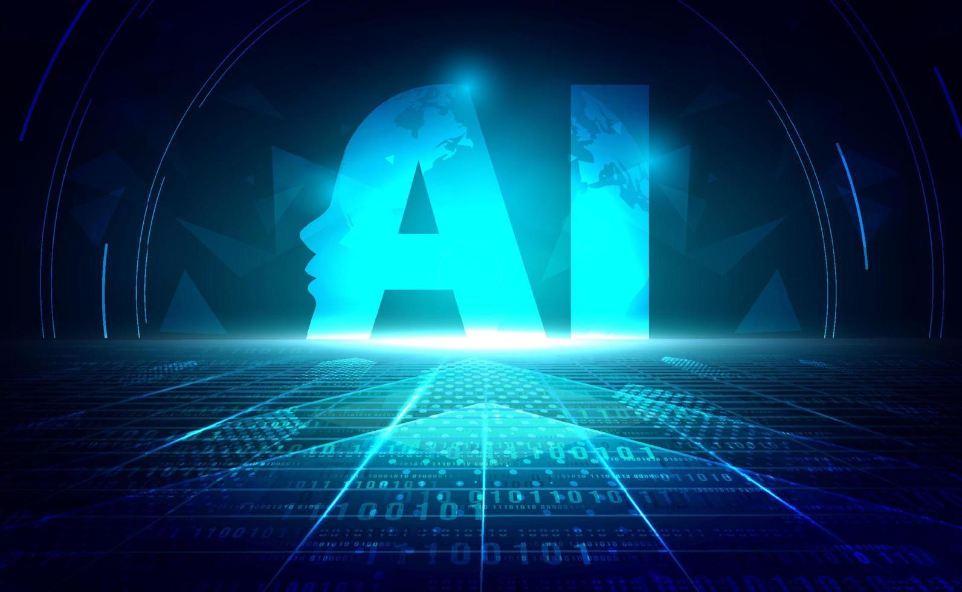
03
Chapter Three
Differentiation & Impact
Why AetherTest changes everything in the testing landscape
From Low-Code to Zero-Touch

Slide 11
Competitive Analysis
AetherTest vs Traditional Tools
Understanding the paradigm shift in test automation
Current Tools
AetherTest
DOM Selector Dependency
Vision-Language Synergy
Rely on ID/XPath/CSS selectors that break with UI changes
"Sees" the UI, identifies elements by appearance and function
Manual Script Authoring
Zero-Scripting
Require developers to write and maintain test code
Goal-based approach—provide the goal, AI figures out the path
Brittle & High Maintenance
Self-Healing by Design
Tests break frequently, consuming 30% of tester time
LLM reasoning adapts to UI changes without human intervention
Post-Development Testing
True Shift-Left
Cannot start until code is stable, delaying feedback
Generate tests from Figma before code is deployed
Selenium • Cypress • TOSCA
Zero-Touch AI Testing
The Paradigm Shift: From Code-Centric to Vision-Centric Testing

Slide 12
Business Impact
Expected Outcomes & Benefits
Quantifiable improvements that transform testing operations
90%
True
Reduction in Scripting Time
Shift-Left Testing
Shift from "Writing Tests" to "Reviewing Results." Testers focus on validation and analysis rather than script creation.
Testing logic generated as soon as Figma design is ready, even before code deployment. Catch issues at design phase.
From Hours to Minutes
Design → Test → Code
Lower
Faster
Total Cost of Ownership
Release Cycles
Eliminates need for specialized automation engineers for routine functional testing. Focus experts on security and performance.
Near-instant validation of features against requirements. Remove testing bottleneck and accelerate time-to-market.
Resource Optimization
Continuous Validation

Slide 13

AetherTest
The Future of Testing
is Autonomous
From Low-Code to Zero-Touch AI Driven Test Automation
Full Traceability
Transparent AI
Effortless Testing
Every action mapped to requirements
Watch the thought process in real-time
Let AI handle the complexity

